Slide 1
Project On Google Play Store Data Analysis
By Subhashree Rameshkumar

Slide 2
Outline
Problem statement
Data overview
Pre processing
Data analysis
Conclusion

Slide 3
Problem statement
As an App development firm, what are the different categories of apps that It can invest in to earn profit ?

Slide 4
Data Source
Google play store customers past history of installs

Slide 5
Data Overview
App | Category | Rating | Reviews | Size | Installs | Type | Price | Content Rating | Genres | Last Updated | Current Ver. | Android Ver
Photo Editor & Candy Camera & Grid & ScrapBook | ART_AND_DESIGN | 4.1 | 159 | 19M | 10,000+ | Free | 0 | Everyone | Art & Design | January 7, 2018 | 1.0.0 | 4.0.3 and up
Coloring book moana | ART_AND_DESIGN | 3.9 | 967 | 14M | 500,000+ | Free | 0 | Everyone | Art & Design;Pretend Play | January 15, 2018 | 2.0.0 | 4.0.3 and up
Sketch - Draw & Paint | ART_AND_DESIGN | 4.5 | 215644 | 25M | 50,000,000+ | Free | 0 | Teen | Art & Design | June 8, 2018 | Varies with device | 4.2 and up
The above table shows the first three instance of the data.
There are 10,500 instances.
There are thirteen attributes in the table.

Slide 6
Pre- processing
Filling null values with mean, based on category
Removal of characters like (+ and , ) from Installs column
Removal of ($) symbol from the price column
Removal of wrong entries, like categorical data being filled in numerical data column

Slide 7



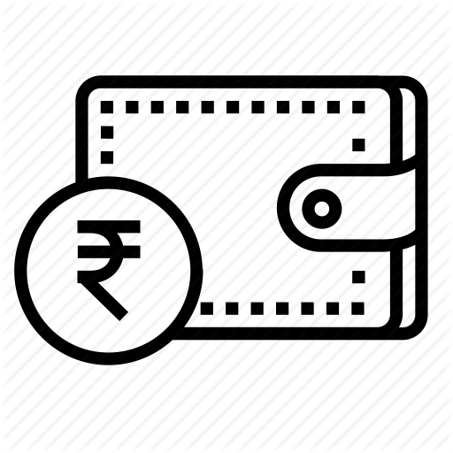
Data analysis
1. Category of apps
Installs
3. Rating
2. Price

Slide 8
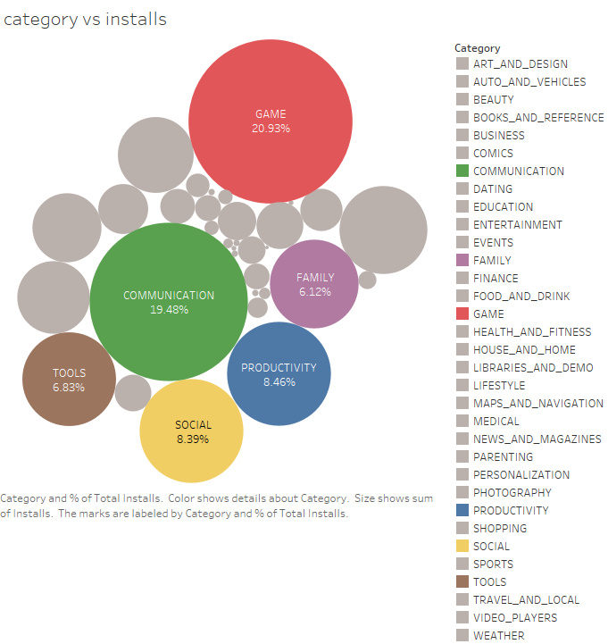
Which category of app’s has most number of installs?
Out of the thirty four categories, the top six categories covers 70% of the total installs.
Hence our target app is narrowed down to these top 6 apps categories based on installs.

Slide 9
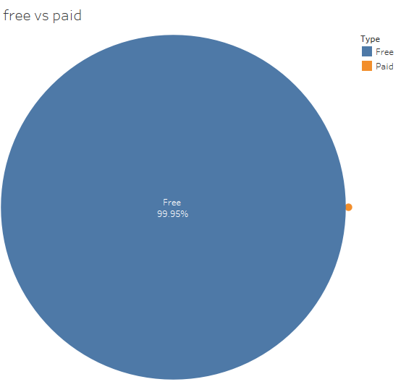
Does the customer prefer free or paid app?
Out of the total apps that were installed, 99.95% of people prefer free apps.
Even though the name free apps deceives us in terms of profit earned by an App developer, It has a larger sponsors from the marketing companies as it covers majority of the audience.

Slide 10
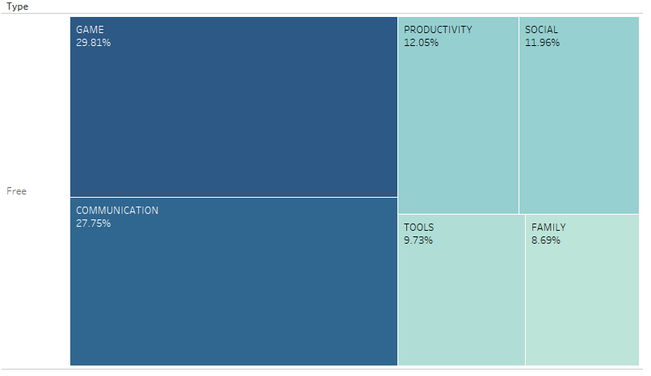
4. Which are the app’s that are most installed in free type ?
The hierarchy of apps that are downloaded in free type is maintained as in general installs.

Slide 11
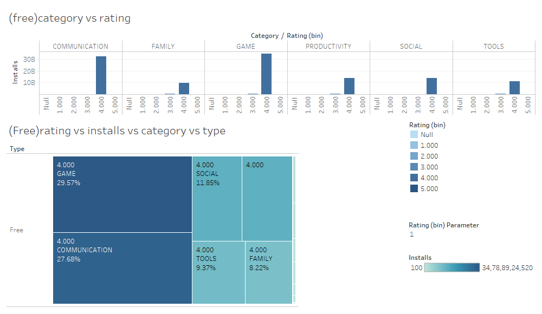
What is the rating given in free type ?
Average rating given by people is four .

Slide 12
6.If upselling a product was a option then ,which are the apps that customer is ready to pay?, how much is the customer ready to pay?
Refer:
https://public.tableau.com/profile/subhashree2398#!/vizhome/Book4_15554846891370/Story1?publish=yes

Slide 13
Conclusion
Top six app categories were narrowed down based on the installs.
Majority of the people prefer only free apps.
Most common rating given for an app is 4.
In the paid apps type, “Family” is the most preferred followed by “Game”. This can possibly be considered for upselling given that there is no supporting data to prove the conversion rate .
Rank | Category | Upsell | Cost
1. | Game | Yes | 3.5 $
2. | Communication | No | ______
3. | Social | No | ______
4. | Productivity | No | ______
5. | Tools | No | ______
6. | Family | Yes | 3.25 $

